Slide 1
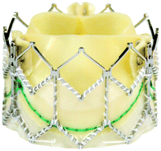
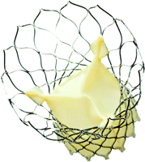
Transcutaneous Aortic Valve Implantation (TAVI)
Dr Sandeep Mohanan
Senior Resident
Government Medical College, Calicut

Slide 2
OVERVIEW
BACKGROUND : AS-EPIDEMIOLOGY?
MANAGEMENT OF AORTIC STENOSIS AND ROLE OF TAVI
THE ADVENT OF TAVI
CURRENT DATA AND EVIDENCE FOR TAVI
TAVI- HARDWARE, PLANNING and PROCEDURE
PROS & CONS OF TAVI
ADVANCES IN TAVI
THE FUTURE FOR TAVI

Slide 3
BACKGROUND - Progression and Natural history of AS
Progression from moderate AS:
- mean velocity increases by 0.3m/s/yr ,
mean gradient increases by 7mmHg/yr,
AVA decreases by 0.1cm²/yr
(depends on leaflet calcification, age, bicuspid valve etc)
Once even mild symptoms develop prognosis drops
Event free survival of severe asymptomatic AS: 30-50% at 2years (AHA 2014 guidelines)
Mortality for symptomatic severe AS : 50% at 2years
(Otto et al. AS. NEJM Aug2014)

Slide 4
BACKGROUND - Progression of AS with age
Prevalence of severe AS among 50-59yrs : 0.2%
among 60-69yrs :1.3%
among >70-79yrs : 3.9%
among octogenarians: 9.8%^{1,2}
With each decade risk of incident AS doubles²
As age increases, disease acceleration also increases¹
Eveborn et al. The evolving epidemiology of valvular aortic stenosis. Heart 2013
Stewart et al. Clinical Factors Associated With Calcific Aortic Valve Disease. JACC 1997

Slide 5
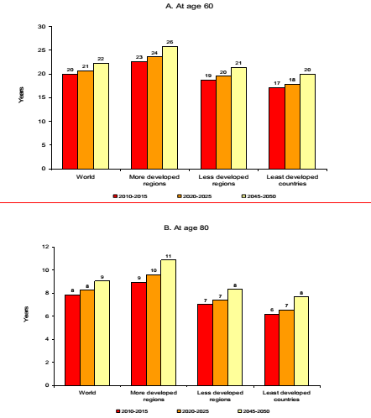
BACKGROUND: Population explosion and AS
-Indian male ~ 67years
Indian female ~ 70 years
(Kerala: ~75 and ~79 yrs resp.)
-India has ~100 Million in population >60 years ³
(9% of total)
➔ ~ 5 million AS !!! ¹
>1/3 of severe AS not suitable for Sx
Aortic stenosis. Indian Heart Journal 2009.
UN data on world population 2013
Indian population statistics 2014

Slide 6
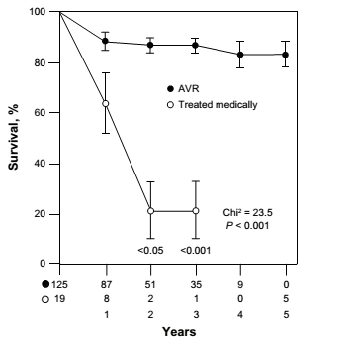
SURVIVAL in AS
Cribier A. Development of transcatheter aortic valve implantation (TAVI): a 20-year odyssey. Arch Cardiovasc Dis. 2012;105(3):146–52

Slide 7
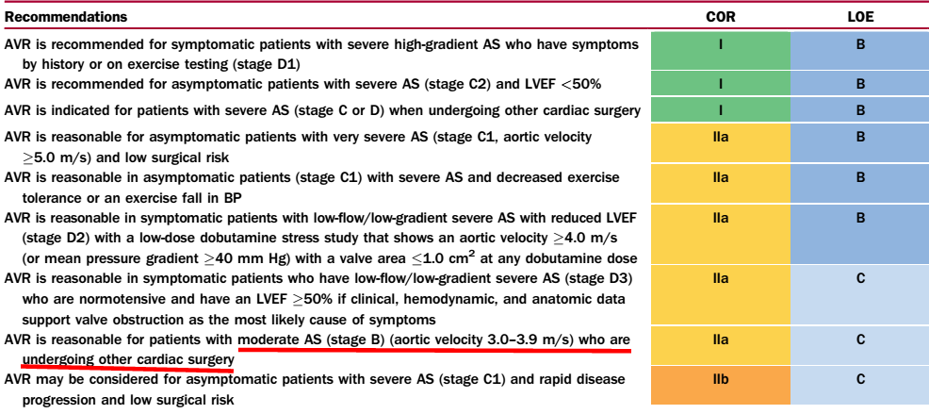
MANAGEMENT OF AORTIC STENOSIS
Medical management has little to offer for severe AS patients
Timing of AVR in AS patients (Valvular Heart Disease AHA guidelines 2014

Slide 8
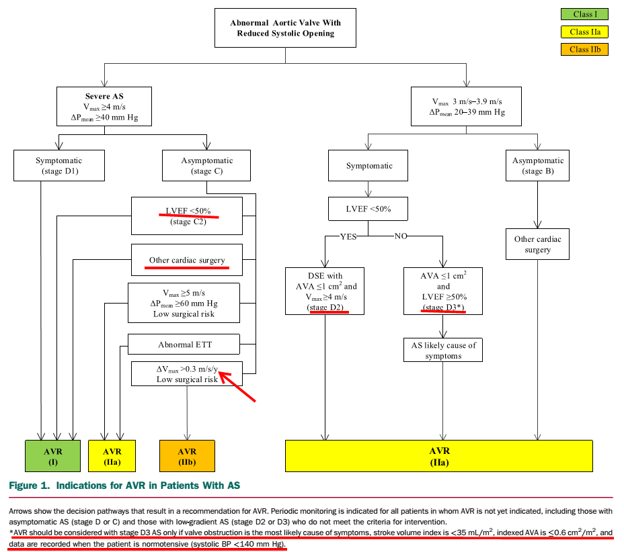
Algorithm for AS management

Slide 9
AHA 2014 on SAVR vs TAVI for AS

Slide 10
NEED FOR TAVI IN AS
Around 1/3rd (27-41%)²of severe AS patients in the real world are deemed unsuitable for surgery → ~50-70-% die by 2years¹
Acquired AS is increasing along with multiple comorbidities
Elderly are scared & reluctant after SAVR risk counselling
People prefer and demand minimally invasive techniques, local anaesthesia and quick discharge
Iung B. The EuroHeart Survey on Valvular heart disease. EHJ 2003
Bach DS et al. Unoperated patients with severe aortic stenosis. JACC 2007

Slide 11
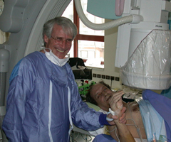
ADVENT OF TAVI
Henning Anderson (1992) : 1st TAVI in a pig model
Dr Alain Cribier (April 16, 2002): 1st TAVI in human
- A bail-out procedure in a very high risk dying patient
“Few innovations in contemporary medicine has captured the imagination as thoroughly as the promise of percutaneous implantation of heart valves”
‘TAVI pandemic’: ~ 1,00,000 TAVI done in 1st decade
Several observational studies in inoperable patients from 2002 to 2008

Slide 12
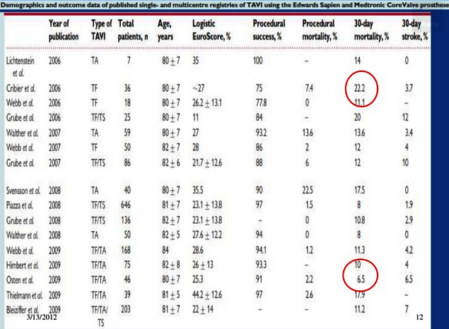
Early data on TAVI

Slide 13
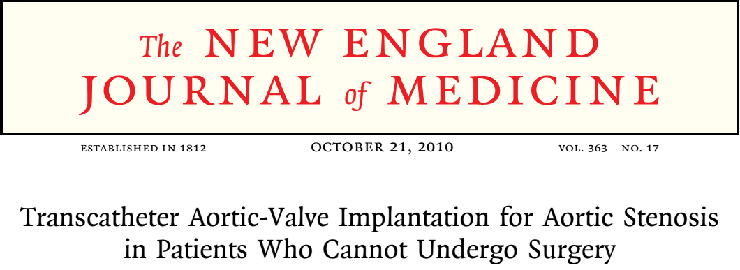
PARTNER trial
Multicenter RCT (US + Europe) from 2007 to 2009
Severe calcific AS (0.8cm ² , 40mmHg, 4m/s ) with high or very high risk
Cohort B : PROM >50% or serious irreversible condition
Cohort A: STS ≥10% or surgeon PROM ≥ 15% based on coexisting morbidity
EXCLUSION: Bicuspid AoV, non-calcified AS, severe CAD requireing revasc., a/c MI, TIA or stroke <6m, LVEF<20%, Aortic annulus<18mm or >25mm, severe MR/AR, advnaced CKD,
TAVI with Edward Sapiens valve (23 or 26mm)

Slide 14
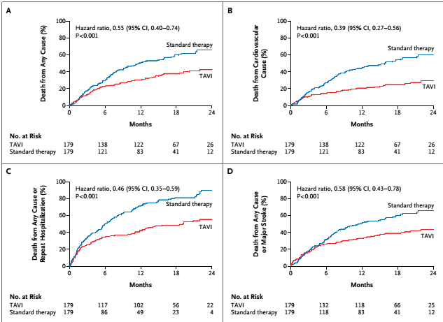
PARTNER Cohort B results
N=358
Mean STS : 11.6 ± 6%
15% porcelain aorta,
13% chest deformity,
24% severe resp illness
23% Frailty
30 day mortality- 6.4%
- ARR ~ 20% at 1 year (30.7% vs 50.7%, P<0.001))
NYHA 3/4 symptoms at 1yr
: 25% vs 58%
TAVI superior
AT 2 years TAVI –> Mortality was 43% for TAVI vs 85% for standard treatment (NNT <3!!!) .
The high mortality is attributed to the significant co-morbidities .
(Makkar et al. Transcatheter Aortic-Valve Replacement for Inoperable Severe Aortic Stenosis . N Engl J Med 2012;366:1696-704.)

Slide 15
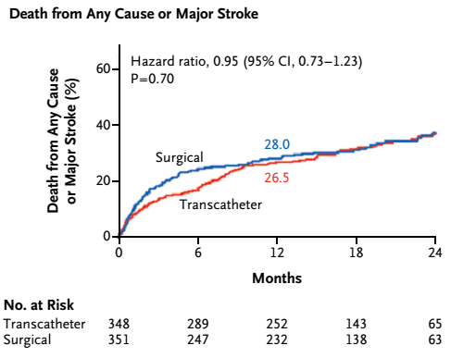
PARTNER Cohort A results
N= 699
30 day mortality-3.4% vs 6.5%
2years:
- Mortality : 34% for TAVI vs 35% SAVR
- no difference in MACCE
Similar benefits in hemodynamics and NYHA
No difference in stroke at 2years
More paravalvular leak for TAVI leading to higher late mortality
More vascular complications (11% vs 3%)
Major bleeding and AF higher for SAVR
Better quality of life for TAVI
Females had mortality benefit in TAVI cohort (JACC April 2014)

Slide 16
PARTNER Cohort A echocardiography

Slide 17
PARTNER Cohort A symptom status

Slide 18
PARTNER Cohort A: Impact of AR
Cause of AR:
Pattern of valve calcification
- Undersizing of the valve
- Valve placement
Even mild AR increased mortality
Moderate/severe AR occured in ~10%

Slide 19
US Core Valve investigators: TAVI vs SAVR in high risk (NEJM May 2014)
Medtronic Core valve (2011-2012)
Heart team PROM> 15%
N=795
mean STS of 7.4%
More people declined SAVR
1 yr mortality—14% vs 19%
SAVR had higher major bleeding, stroke, AF and AKI
TAVI had more PPIs and vascular complications
Noninferior for NYHA, quality of life and echo-indicis
All TAVI attributed complications decreased significantly from previous analysis
TAVI is superior to SAVR

Slide 20
TAVI HARDWARE & PREPROCEDURAL PLANNING

Slide 21
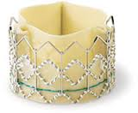
EDWARDS SAPIEN VALVE (Edwards Lifesciences, Irvine, CA).
SAPIEN THVS: model of the 1st human TAVI
Approved in Europe in 2007 and USA in Nov 2011
Balloon expandable stainless steel stent frame
3 bovine pericardial leaflets
Inner polyethylene terephthalate fabric skirt in bottom portion to prevent leak
The system is crimped onto a balloon catheter
‘23mm’: 18 -22mm annulus, 22F , MVD -7mm
‘26mm’: 21 -25mm annulus, 24F, MVD - 8mm

Slide 22
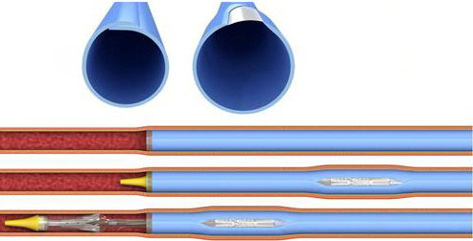
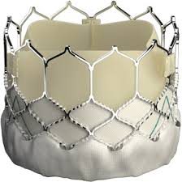
EDWARDS SAPIENS newer gen valves
SAPIEN XT:
-Cobalt chromium stent frame → more radial strength
New leaflet geometry→ Better function ,
coaptation and lower profile
23mm (18F), 26mm (19F), 29mm
- 16 F is esheath is used
- Up to 27mm annulus size
SAPIEN 3:
14 F
Additional outer PET fabric skirt
20mm, 23mm, 26mm, 29mm
Annulus size from 16mm to 28mm
No deaths, stroke, vascular compl or >2+PVL in
a study on 15 patients
(Binder et al. TAVR with Sapien 3. JACC Cardiovasc Interv 2013)

Slide 23
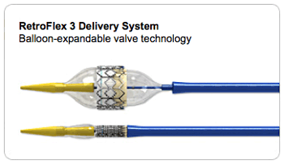
EDWARDS SAPIEN Delivery systems
TRANSFEMORAL
Retroflex system: SAPIEN THV
Novaflex system: SAPIEN XT
Commander system: SAPIEN 3
TRANSAPICAL/ TRANSAORTIC
Ascendra/ Ascendra plus sytems: SAPIEN THV & XT
Certitude system : SAPIEN 3
Notes:
Retroflex: Balloon cathter wrapped within a deflectable catheter: helps pushing, manoeuvring across aortic arch and native valve
Novaflex: reduces the delivery profile
Commander: more flexibility, allows fine adjustments of position

Slide 24
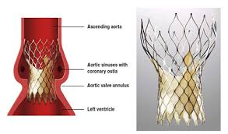
COREVALVE RE-VALVING SYSTEM (Medtronic, Minneapolis)
A trileaflet porcine pericardial bioprosthetic valve
Mounted in a multilevel self-expanding Nitinol frame
Upper third- low radial force - sits in the ascending aorta so as to orient the valve into the aortic root
Middle third - high hoop strength (valve attached here)
Lower third- high radial strength- sits in the LVOT --has a skirt of pericardium that seals the system
Notes:
Nitionol: memory, expansion to predetremined sizes, more malleble at cool, firm and strong when warm

Slide 25
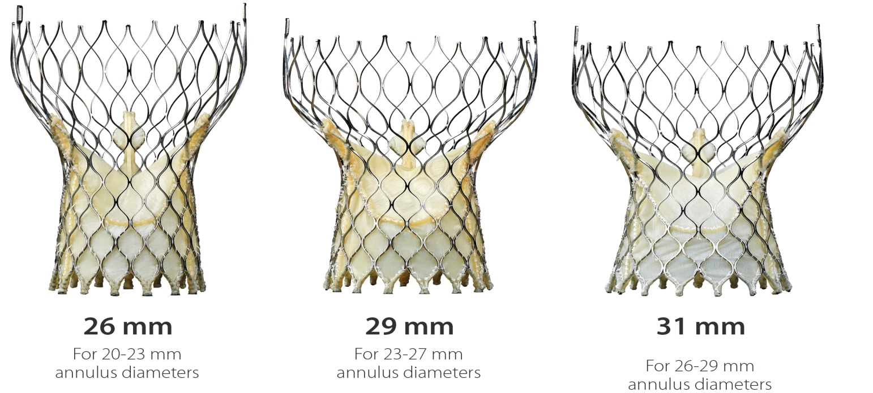
Core valve sizes and anatomic requirements
18 F sheath
MAD- 6mm

Slide 26
TAVI selection criteria
Patient and prosthesis selection are crucial in determining outcomes
HEART TEAM: Cardiologist, CVTS, cardio-radiologists, cardiac-anaesthetists
Patient selection: STS score >10% / Logistic Euroscore >20%/ severe risk factors not covered by risk-scores²
TAVR is acceptable only in severe AS patients with
1) a life expectancy of >1 year, and
2) those with a chance of “survival with benefit” of >25% at 2 years
3) favourable anatomy for TAVI
1.Al-lamee et al. TAVI: Current principles of patient and technique selection and the future. Circulation 2011.
2. TAVI for patients with aortic stenosis: a position statement from EACTS and the ESC, in collaboration with the EAPCI.
Eur Heart J. 2008;29:1463–147

Slide 27
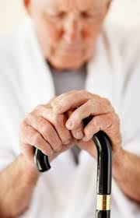
Patient-selection considerations :TAVI vs SAVR
Frailty: >1/4th over 65 years and >1/3rd over 80 years
(Frailty in Elderly people. Indian journal of Gerontology, 2011)
Co-morbid conditions : CAD, COPD, CKD, Cirrhosis, Stroke/TIA, Malignancy, Immunodeficiency, Severe MR/TR/AR/PAH
Concomitant CAD : SVD/ TVD
Surgical Risk : STS-PROM at 30days
- Low : <4%
- Intermediate: 4-8%
- High: >8-15%
- Prohibitive : >15%, >50% all-cause mortality risk at 1 year , porcelain aorta, prior radiation, post bypass surgery with adherent grafts to chest wall, ≥3 major organ dysfunction
Patient preference
Notes:
Frailty indices – based on dependency, daily activities and cognitive function
Frailty score: Based on loss of ADL, Serum albumin, walking 15 feet in 7 sec,grip strength <30kg for male and 18 kg for female

Slide 28
Surgical risk scores for TAVI
Logistic Euroscore often overestimates mortality
STS is more accurate but still has suboptimal predictive power
Recent RCTs have used STS in stratifying patients
Clinical risk assessment, anatomic characterisation and functional assessment are vital for optimal TAVI results
1.The Society of Thoracic Surgeons 2008cardiac surgery risk models: part 2—isolated valve surgery. Ann ThoracSurg. 2009;88:S23–S42.
2. Relationship between the logistic EuroSCORE and the Society of Thoracic Surgeons Predicted Risk of Mortality score in patients implanted with the CoreValve ReValving system—a Bern-Rotterdam Study.Am Heart J. 2010;159:323–329.

Slide 29
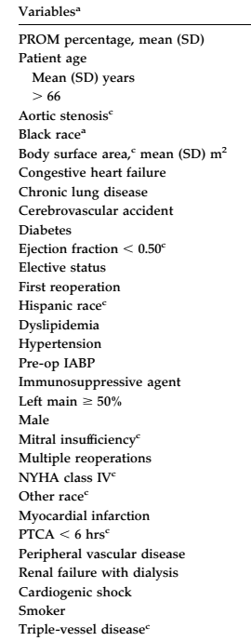
An exercise to remember :STS-PROM and its influence on decisions
70 year old male, HTN, mild MR, mild COPD, NYHA II, S.Cr-1.6 (most common AS patient)
STS PROM ~ 4% (intermediate risk)
Slightly increase his risk → by S.Cr 2.0 / Diabetes
add any 1 of advanced COPD/old MI/old CVA/ LV dysfunction /POAD / NYHA 3
➔ STS PROM>8% (High risk!!)
(This is excluding frailty, octogenerians and all anatomic factors!!)
The real world is full of intermediate/high risk patients....

Slide 30
Pre-TAVI work up
Clinical assessment: Decompensated patients may require CCU care ± BAV before TAVI vs SAVR
Coronary assessment: CAG, MSCT
Annulus assessment:
Minimize paravalvular AR
Avoid device migration
Valve selection → Valve size slightly greater than annulus size
Other relevant cardiac anatomy: LV anatomy and function, mitral valve, LVOT,bicuspid valve, valve calcification, coronary ostia, angulation of ascending aorta, aortic wall anatomy/calcification
Assessment of peripheral arterial system

Slide 31
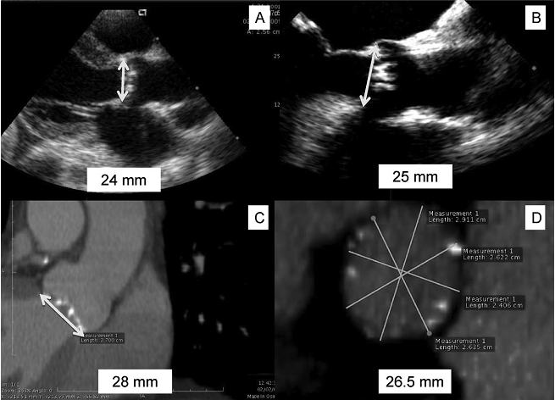
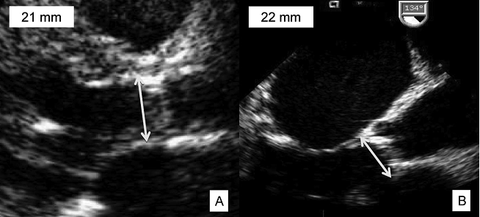
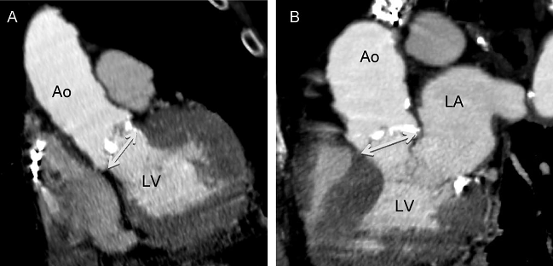
Annulus assessment
TTE
TEE
TTE/TEE – PLAX & 3C
- Oval annulus precludes correct meurements
MSCT – Min diameter in sagittal section
Aortography - RAO & LAO 15⁰
Rotational angiogram
cMRI
3D TEE
MSCT >TEE >TTE
(Integrated approach)
MSCT- Sagittal
MSCT- Coronal

Slide 33
Other relevant cardiac anatomy
LV : function, dimensions and thrombus
Mitral valve: MR, s/p MVR
LVOT: Diameter, stenosis, LVH, Sigmoid septum (apical approach)
AoV anatomy: Bicuspid valve( elliptical, root dilation, PVL- relative C/I)
: Large calcific nodules ( C/I)
Aortic size & angulation: Horizontal aortic root & vertical annulus
:Aortic root >45mm at STJ (C/I for Corevalve)
Aortic calcification: porcelain aorta → dissection, stroke, embolism
Coronary ostial height: >10mm (If <10mm: coronary obstruction vs AV block)
Al-lamee et al. TAVI: Current principles of patient and technique selection and the future. Circulation 2011.

Slide 34
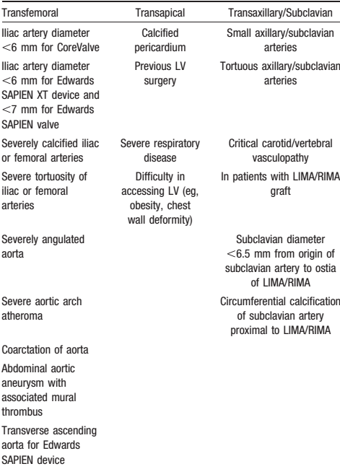
Assessment of the peripheral arteries
Contraindications for access selection
Device and access selection
MLD, calcification and tortuosity of femorals, iliac and aorta
Transfemoral has lower vascular complications and a survival benefit compared to transapical route¹
PAG, MSCT, MRA
1.Results of transfemoral or transapical aortic valve implantation following a uniform assessment in high-risk patients with aortic stenosis.J Am Coll Cardiol. 2009;54:303–311

Slide 35
TAVI PROCEDURE

Slide 36
Balloon aortic valvuloplasty
Also pioneered by Cribier - 1986
Helps as a rehearsal: assessment of RVP
Cracks calcification and stretches aortic wall: Easier crossing and better deployment
Crucial for Edwards Sapien and less for low profile Core Valve device
Disadvantages: Higher procedure time, costs, need for RVP, more complications, independent risk factor for PPI¹
* “Simplified TAVI” has been studied for CoreValve(18F) in 60 TAVI procedures with similar efficacy
1. Grube et al. Feasibility of transcatheter aortic valve implantation without balloon pre-dilation: a pilot study. J Am CollCardiol Intv 2011;4:751–7

Slide 37
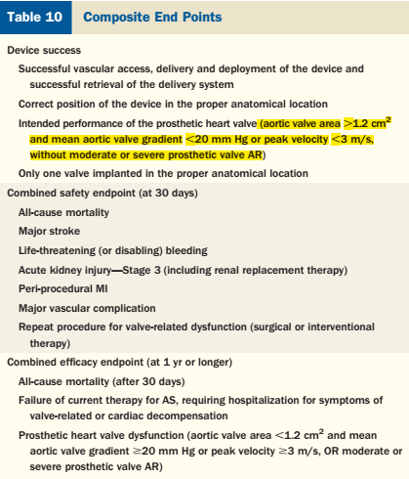

Slide 38
PROS OF TAVI

Slide 39
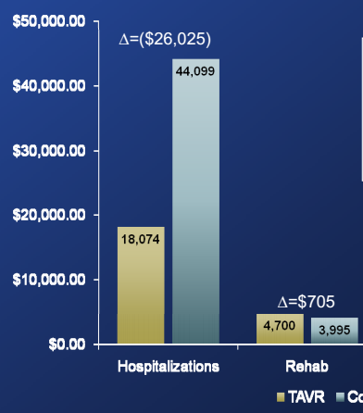
Economic impact and quality of life?
Quality of life is significantly more for femoral TAVR patients
Femoral TAVR had better economic savings and QALYs compared to SAVR at 1 year¹
Initial costs are however very high!!!
1. Cost analysis of TAVR vs SAVR from Partner Cohort A, JACC 2012

Slide 40
HEMODYNAMICS
Coronary blood flow: Significant increase in coronary flow associated mostly with a decrease in LVEDP¹
(TEE Doppler study in 90 patients after Edward Sapiens)
TAVR patients had higher indexed EOA and lower prosthesis-patient mismatch.²
Most paravalvular AR is mild and non-progressive
Even >75% of moderate AR regress to trivial at 1 year (NEJM 2014)
Coronary blood flow in patients with severe aortic stenosis before and after transcatheter aortic valve implantation. AJC 2014
Hahn et al. Comparison of transcatheter and surgical aortic valve replacement in severe aortic stenosis: a longitudinal study of echocardiography parameters in cohort A of the PARTNER trial (placement of aortic transcatheter valves).J Am Coll Cardiol.2013 Jun 25;61(25):2514-21.
Kim et al. A critical review of hemodynamic changes and left ventricular remodeling after surgical aortic valve replacement and percutaneous aortic valve replacement.Am Heart J. 2014 Aug;168(2):150-9.e1-7.

Slide 41
PATIENT BENEFIT
Females: PARTNER A found high-risk females who underwent TAVI had better survival compared to SAVR.
( Sex-related differences in outcomes after transcatheter or surgical aortic valve replacement in patients with severe aortic stenosis: Insights from the PARTNER Trial . J Am Coll Cardiol. 2014 Apr 22;63(15):1522-8.)
Diabetics: Diabetics in PARTNER trial (N=275) had significant benefit compared to SAVR(18 % vs 27% at 2years)
(Transcatheter Versus Surgical Aortic Valve Replacement in Patients With Diabetes and Severe Aortic Stenosis at High Risk for SurgeryAn Analysis of the PARTNER Trial. JACC 2014)
Renal dysfunction : Poor outcomes in SAVR, not TAVI
(Impact of varying degrees of renal dysfunction on transcatheter and surgical aortic valve replacement.J ThoracCardiovasc Surg.2013 )
Major Bleeding : 13% in TAVI vs 35% in SAVR
(Bleeding complications after surgical aortic valve replacement compared with transcatheter aortic valve replacement: insights from the PARTNER I Trial. J Am Coll Cardiol 2014 Mar 25;63(11):1100-9)
O2 dependent COPD : Better outcomes with TAVI
(Outcomes of patients with chronic lung disease and severe aortic stenosis treated with transcatheter versus surgical aortic valve replacement or standard therapy: insights from the PARTNER trialJ Am Coll Cardiol. 2014 Jan 28;63(3):269-79.)
Mod-severe MR : Increased 2 year mortality for SAVR, not TAVI
(Impact of preoperative moderate/severe mitral regurgitation on 2-year outcome after transcatheter and surgical aortic valve replacement: insight from the Placement of Aortic Transcatheter Valve (PARTNER) Trial Cohort A.Circulation. 2013 Dec)

Slide 42
CONS OF TAVI

Slide 43
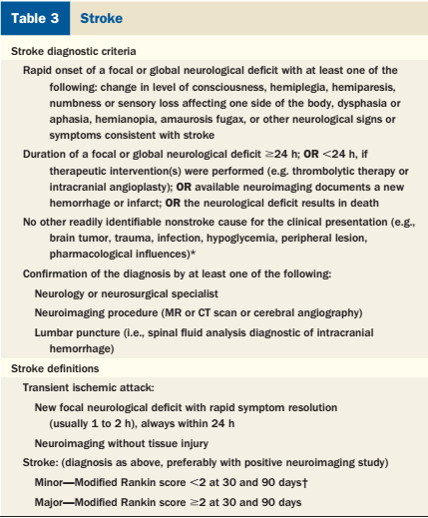
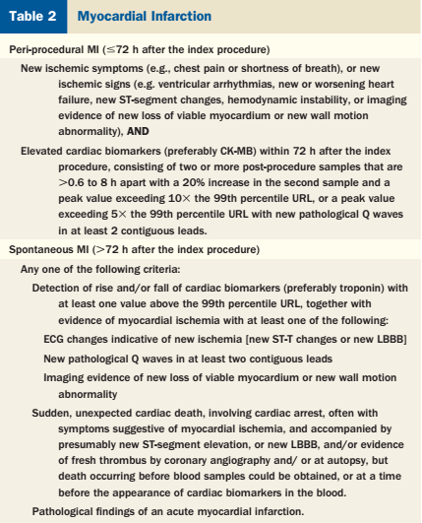
VARC definitions of complications

Slide 44
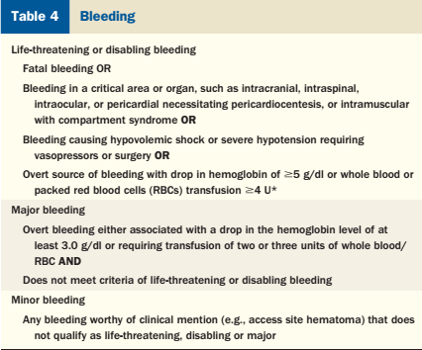
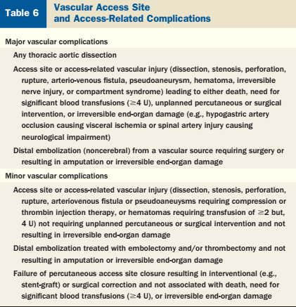
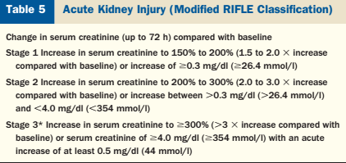
VARC definitions of complications

Slide 45
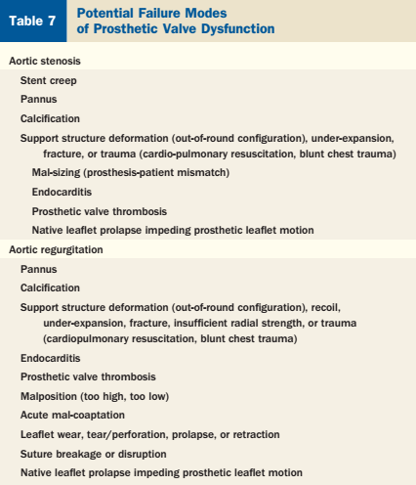
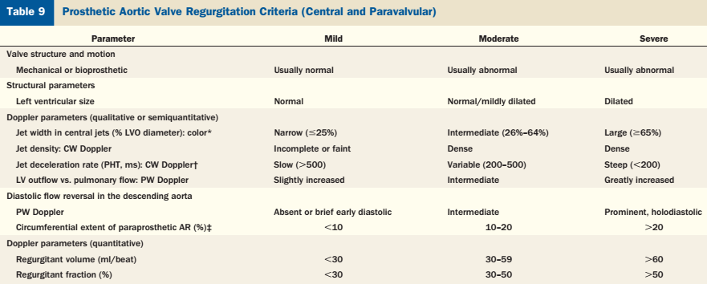
VARC definition on prosthetic valve
>4
>35

Slide 46
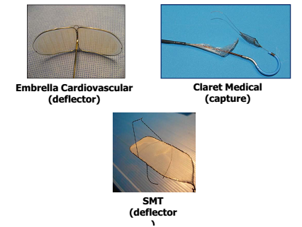
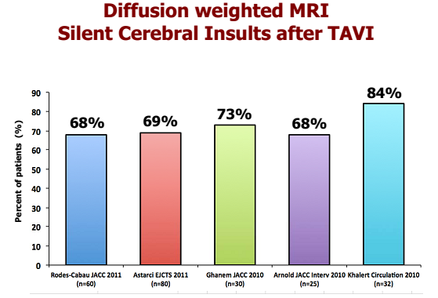
STROKE after TAVI
PARTNER-A : 8.3% TAVI vs 4.3% SAVR
BERN-TAVI registry(Wenaweser et al EHJ 2013) → 3.9% TAVI vs 3.2 % SAVR
Wire, catheter, aortic anatomy, BAV, RVP, comorbidities, AF
Silent infarcts→ No influence on neurocognitive performance
Embolic protection devices and lower profile devices may help

Slide 47
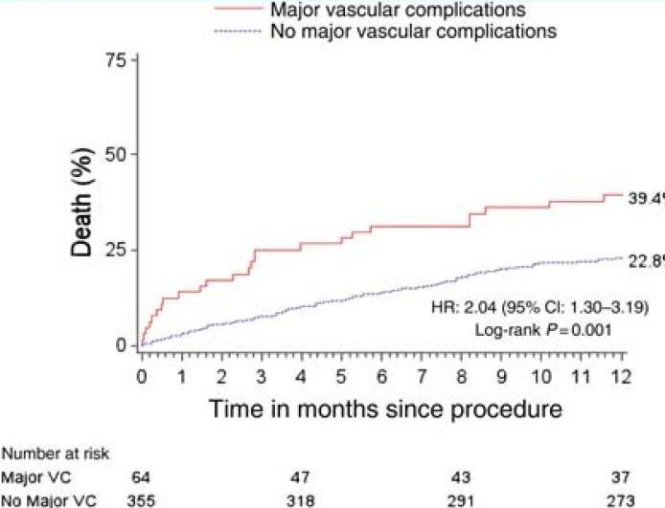
Vascular complications after TAVI
PARTNER A : 18% TAVI vs 4.8% SAVR
Core Valve study : 11%
VARC metanalysis(2012) – 6 to 11.9%
Patient selection,imaging, sheath size, device profile
Edwards esheath, vascular closure devices
Transcatheter Aortic Valve Implantation: 10-year Anniversary. Part II. Eur Heart J. 2012;33(19):2399-2402

Slide 48
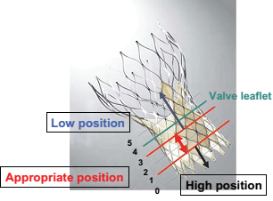
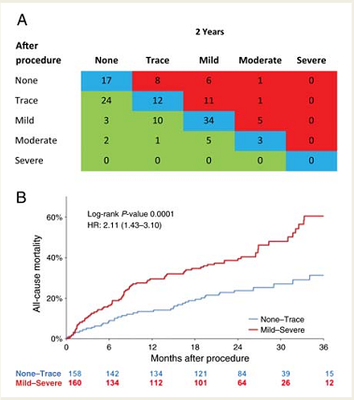
Paravalvular leak after TAVI
PARTNER A: >2+ AR in 7% TAVI vs 1.9% SAVR
(predictor of higher mortality)
Core-Valve study(2014) : 6% had >2+ AR
Atleast mild AR → >50%
→76% of those with mod/severe AR→ mild or no AR at 1 yr
Mechanisms of AR: 1) Malposition, 2) Undersizing, 3) Underexpansion, 4) malapposition, 5) Aggressive BAV
AR predictors: 1) “Cover index” <8% for Edward Sapiens
(100* Prosthesis D- Annulus D(by TEE) / Prosthesis D)→ prosthesis-annulus discongruence)
2)Valve calcification degree and symmetry, 3) operator experience
4) LVOT angle and depth of implantation for CoreValve
PARTNER Trial Investigators. Two-year outcomes after transcatheter or surgical aortic-valve replacement. N Engl J Med2012;366:1686 –1695
Determinants of significant paravalvular regurgitation after transcatheter aortic valve: implantation impact of device and annulus discongruence. JACC Cardiovasc Interv. 2009 Sep;2(9):821-7.

Slide 49
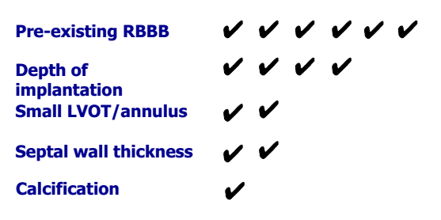
Pacing after TAVI
The AV node and LBB lies close to the NCC
Conventional SAVR in octogenarians¹- 8.5%
TAVI with Edwards SAPIEN - 5.4% pacing
TAVI with CoreValve² -9.3% to 33%
New LBBB occurred in 40% after CoreValve TAVI
Continuous in-hospital rhythm monitoring for 48-72hrs with TPI back up.
1. Dawkins et al.Permanent pacemaker implantation after isolated aortic valve replacement:incidence, indications, and predictors. Ann Thorac Surg. 2008;85:108 –112.
2. Jilaihawi et al.Predictors for permanent pacemaker requirement after transcatheter aortic valve implantation with the CoreValve bioprosthesis. Am Heart J. 2009;157:860 – 866

Slide 50
Other complications
DAPT after TAVI:
Aspirin and clopidogrel for 3-6m
SAPT has also been tried with no adverse effects
No consensus
Coronary obstruction and MI
Bleeding complciation
Acute kidney injury

Slide 51
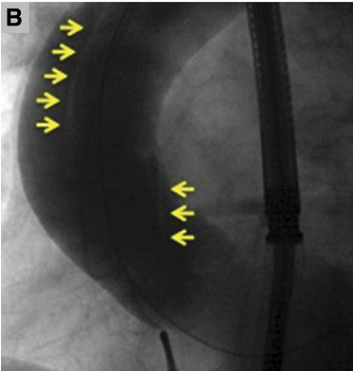
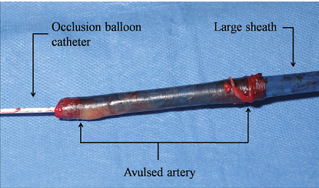
Rare life-threatening complications

Slide 52
OFF-LABEL INDICATIONS

Slide 53
Valve-in-valve TAVI
Bio-prosthetic aortic valve failure & post-TAVI failure
Reoperation in patients with degenerated bioprostheses carries an mortality risk ranging from 1.5% to 23% depending on co-morbidities¹
1st case : 82 yr female with degenerated Perimount- 2008
Valve-in Valve in ~134 patients (as of 2011)
Transapical (70%) > transfemoral(25%)
Preferably not for paravalvular leak
Global success rates ~96%
1. Vogt et al.Reoperative surgery for failing aortic prosthesis: predictors of mortality. Eur J CardioThorac Surg 2000.
2. Transcatheter Heart Valves for Failing Bioprostheses State-of-the-Art Review of Valve-in-Valve Implantation.
Circulation 2011

Slide 54
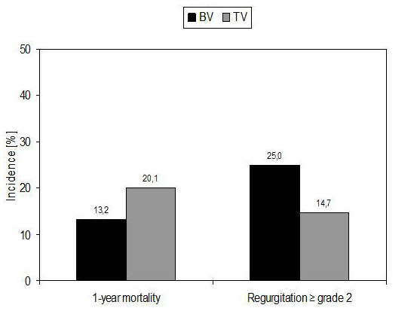
TAVI in Bicuspid aortic valve
Exclusion criteria in RCTs
Elliptical annulus, asymmetric calcium distribution, larger annulus
In a recent analysis of 21 BAV patients who underwent TAVI
→No significant difference in device success (100% vs 92.8%; P=0.37), risk of annulus rupture or valve migration.
→Post-procedural mean gradient , aortic regurgitation ≥2 of 4, 30-day mortality were also similar in both group
ESC Congress 2013
N=32 bicuspid valve
Transcatheter aortic valve implantation for patients with severe bicuspid aortic valve stenosis
Circ Cardiovasc Interv. 2013 Jun;6(3):284-91.

Slide 55
Intermediate and low-risk cohort
Wenaweser et al (Swiss registry): N=389 (2009-2011)
: low(41) vs intermediate (254) vs high risk (94)
→Low risk fared the best (HR=0.38, P<0.01)¹
30 day mortality in low risk- 2.4% ( vs 5% and 15% respectively)
~40-50% of low/intermediate STS are actually high risk
➔ frailty ( >1/4th over 65 years and>1/3rd over 80 years )
(Frailty in Elderly people. Indian journal of Gerontology, 2011)
Ongoing trials in intermediate risk : PARTNER 2 and SURTAVI trials
1. Wenaweser et al. Clinical outcomes of patients with estimated low or intermediate surgical risk undergoing transcatheter aortic valve implantation. Eur Heart J (2013) 34 (25): 1894-1905.

Slide 56
Difficult peripheral anatomy
Transaortic approach - Corevalve
Subclavian approach- Corevalve

Slide 57
PCI-TAVR or Hybrid-TAVR
~ 75% requiring AVR have CAD.
Staged procedure
Hybrid LIMA to LAD+ PCI to LCX & RCA + TAVR

Slide 58
TAVI for AR
N=43 patients underwent TAVI with the CoreValve prosthesis
mean age- 75.3 ± 8.8 years
mean logistic EuroSCORE : 26.9 ± 17.9%;
mean STS: 10.2 ± 5.3%.
Implantation of a TAVI→ 42 patients (97.7%),
8 patients (18.6%) required a second valve during the index procedure for residual aortic regurgitation.
Post-procedure AR grade I or lower→ 34 patients (79.1%).
At 30 days, the major stroke incidence was 4.7%,
30-day all-cause mortality rate was 9.3% and at 12m was 24%.
→ Feasible in very high risk with several technical challenges
Roy et al.Transcatheter aortic valve implantation for pure severe native aortic valve regurgitation. JACC2013 Apr

Slide 59
ADVANCES in TAVI

Slide 60
2nd generation TAVI valves
Easier deployment, better apposition and less complications
Lower profile -14 F
Retrievable valves
Higher durability
Dedicated bicuspid aortic valve
Nanotechnology based- 10F

Slide 61
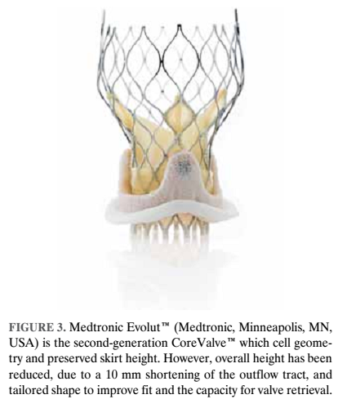
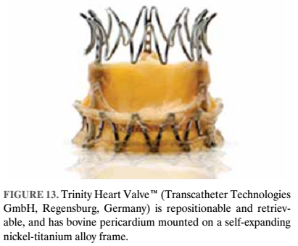
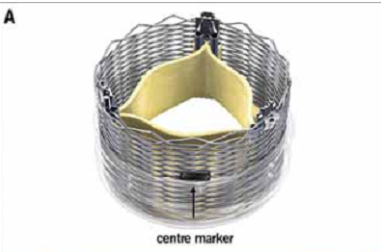
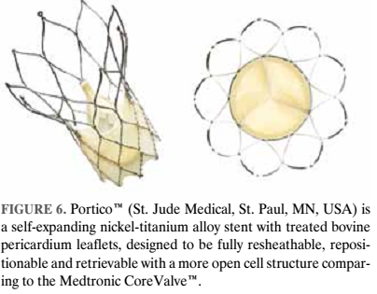
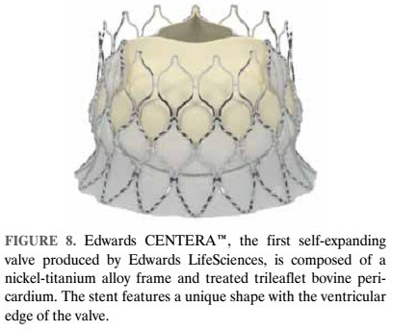
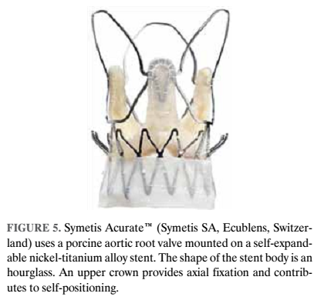
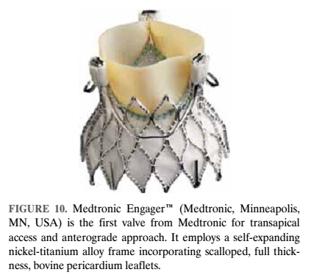
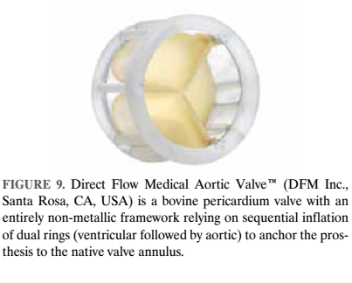

Slide 62
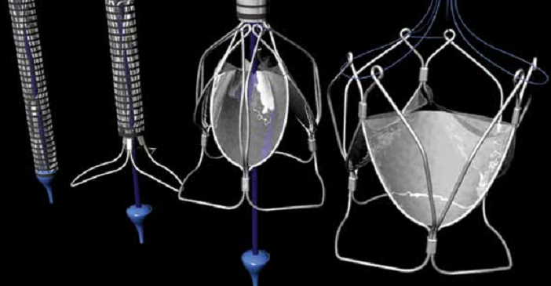
UCL-TAV valve - polymeric leaflets with high durability and minimal calcification
Tissue-engineered valve- implanted b.m. Mononuclear cells → self-repair

Slide 63
Advances in imaging
3mensio valve imaging with Phillips HeartNavigator sytem
Dyna CT(Siemens) imaging

Slide 64
The Future for TAVR
TAVR is being improved and improvised upon.
The current lack of enough guideline-support
➔ urgent need for more evidence/guidelines
SAVR TAVR has shown benefits TAVR>>SAVR TAVR
(awaiting conquest) (PARTNER2 & SURTAVI) (NEJM2011) (NEJM 2010)
eagerly awaited) (NEJM 2014) (JACC 2014)

Slide 65
Conclusion
HEART-TEAM concept is supreme : Weigh evidence and choose the best in concordance to the wishes of our patient
TAVI is now proven superior to SAVR in high-risk cohorts.
Optimism is in the air: 1st TAVR in India(Feb 2011)
TAVI can be a true success once we identify people that may die due to AS from the group that may die with AS

Slide 66
Sometimes, “it is more important to know what sort of a person has a disease than to know what sort of a disease a person has.” (Hippocrates)
THANK YOU

Slide 67
QUIZ

Slide 68
1. TIA after TAVI?

Slide 69
2. Chest pain after TAVI?

Slide 70
3. Post TAVI complication?

Slide 71
5. Progressive dyspnoea after 1 year of TAVI?

Slide 72
6. 6months after aTAVI?

Slide 73
7. Cardiogenic shock immediately after TAVI?

Slide 74
8. Name this valve?

Slide 75
References
Prog Cardiovasc Dis. 2014 May-Jun;56(6):619-24. doi: 10.1016/j.pcad.2014.02.004. Epub 2014 Mar 3.Outcomes of surgical aortic valve replacement: the benchmark for percutaneous therapies.Bajona P
JAMA. 2013 Nov 20;310(19):2069-77. doi: 10.1001/jama.2013.282043. Outcomes following transcatheter aortic valve replacement in the United States.Mack MJ¹,
Ann Thorac Surg. 2014 Jan;97(1):22-8. doi: 10.1016/j.athoracsur.2013.09.088. Epub 2013 Nov 19. Transapical versus transfemoral aortic valve implantation: a multicenter collaborative study.van der Boon RM¹
J Am Coll Cardiol. 2013 Feb 26;61(8):830-6. doi: 10.1016/j.jacc.2012.11.050. Epub 2013 Jan 16.Transcatheter aortic valve implantation with the Edwards SAPIEN versus the Medtronic CoreValve Revalving system devices: a multicenter collaborative study: the PRAGMATIC Plus Initiative (Pooled-RotterdAm-Milano-Toulouse In Collaboration).Chieffo A¹
J Am Coll Cardiol. 2014 Apr 22;63(15):1522-8.Sex-related differences in outcomes after transcatheter or surgical aortic valve replacement in patients with severe aortic stenosis: Insights from the PARTNER Trial (Placement of Aortic Transcatheter Valve).Williams M¹
J Thorac Cardiovasc Surg. 2013 Dec;146(6):1399-406; discussion 13406-7.Impact of varying degrees of renal dysfunction on transcatheter and surgical aortic valve replacement.Nguyen TC¹
J Cardiovasc Med (Hagerstown). 2012 Apr;13(4):229-41. Transcatheter vs. surgical aortic valve replacement: a retrospective analysis assessing clinical effectiveness and safety.Fusari M¹
J Thorac Cardiovasc Surg. 2013 Mar;145(3 Suppl):S11-6. doi: 10.1016/j.jtcvs.2012.11.051.A comprehensive review of the PARTNER trial.Svensson LG
Catheter Cardiovasc Interv. 2013 Apr;81(5):871-81. doi: 10.1002/ccd.24623. Epub 2012 Sep 24.Clinical profile and outcome of patients with severe aortic stenosis at high surgical risk: single-center prospective evaluation according to treatment assignment.Dvir D
Cardiovasc Revasc Med. 2011 Nov-Dec;12(6):345-9.Comparison between Society of Thoracic Surgeons score and logistic EuroSCORE for predicting mortality in patients referred for transcatheter aortic valve implantation.Ben-Dor I
Catheter Cardiovasc Interv. 2012 Jul 1;80(1):128-38. Meta-analysis of complications in aortic valve replacement: comparison of Medtronic-Corevalve, Edwards-Sapien and surgical aortic valve replacement in 8,536 patients.Jilaihawi H¹
J Am Coll Cardiol. 2014 Jan 28;63(3):269-79. Outcomes of patients with chronic lung disease and severe aortic stenosis treated with transcatheter versus surgical aortic valve replacement or standard therapy: insights from the PARTNER trial (placement of AoRTic TraNscathetER Valve).Dvir D
J Am Coll Cardiol. 2014 Mar 25;63(11):1100-9. Bleeding complications after surgical aortic valve replacement compared with transcatheter aortic valve replacement: insights from the PARTNER I Trial (Placement of Aortic Transcatheter Valve).Généreux P

Slide 76
Circulation. 2013 Dec 24;128(25):2776-84.Impact of preoperative moderate/severe mitral regurgitation on 2-year outcome after transcatheter and surgical aortic valve replacement: insight from the Placement of Aortic Transcatheter Valve (PARTNER) Trial Cohort A.Barbanti M¹
J Am Coll Cardiol. 2013 Jun 25;61(25):2514-21.Comparison of transcatheter and surgical aortic valve replacement in severe aortic stenosis: a longitudinal study of echocardiography parameters in cohort A of the PARTNER trial (placement of aortic transcatheter valves).Hahn RT
Am Heart J. 2014 Aug;168(2):150-9.e1-7. A critical review of hemodynamic changes and left ventricular remodeling after surgical aortic valve replacement and percutaneous aortic valve replacement.Kim SJ

